Slide 1
Infosys Springboard Virtual Internship
Team Details
Project Name: FoodTrends: Understanding Customer Preferences in F&B
Group ID: Team A, Group 1, Batch-11
Team Members: Lekhana S.R
Harshini Ganesan
Jai Akash L J
Abhinit Kumar
Mentor: Ms. Nityasree

Slide 2
Objective
Decode Customer Personas: To transform demographic data (Age, Income, Occupation) into "Customer Profile Intelligence" that identifies who the high-value diners are.
Analyze Ordering Ecosystems: To map "Ordering Patterns & Platform Behavior," determining whether customers prefer direct interaction or digital delivery apps.
Evaluate Service Excellence: To measure "Delivery Experience & Quality" by correlating wait times and food freshness with overall customer satisfaction ratings.
Identify Market Drivers: To uncover "Cuisine Performance & Influence Factors" (like discounts and health concerns) to help restaurants optimize their menus and promotions.

Slide 3
Execution & Milestone Reviews
Dataset Source: The dataset (order final.xlsx) contains 388 records of customer orders with 35 features including Age, Gender, Monthly Income, Rating, and Food Preferences.
Milestone Breakdown:
Milestone 1: Dataset Review & Initial Analysis
  Inspected the data for null values and data types.
  Identified key variables: Customer demographics and behavioral attributes.
Milestone 2: Data Cleaning & Basic Visualization
  Handled categorical data conversion.
  Analyzed gender distribution and age groups using histograms.
Milestone 3: Advanced Analysis
  Explored correlations between Monthly Income and Order Amount.
  Studied the "Influence of Ratings" and "Health Concern" on final order decisions.
Milestone 4: Final Reporting
  Synthesized conclusions based on wait times and affordability.
  Finalized the predictive insights for F&B vendors.

Slide 4
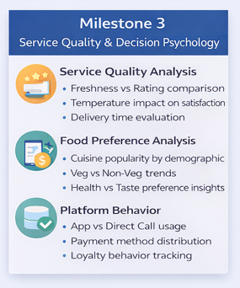
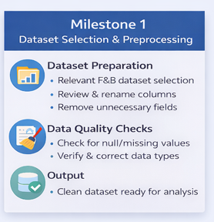
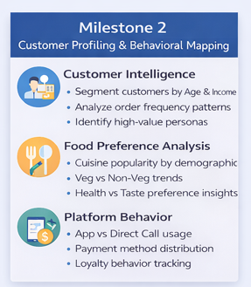
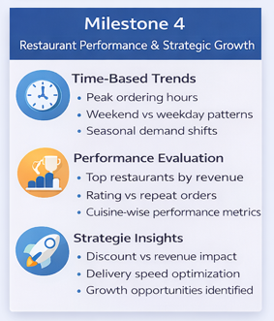
Project milestones:

Slide 5
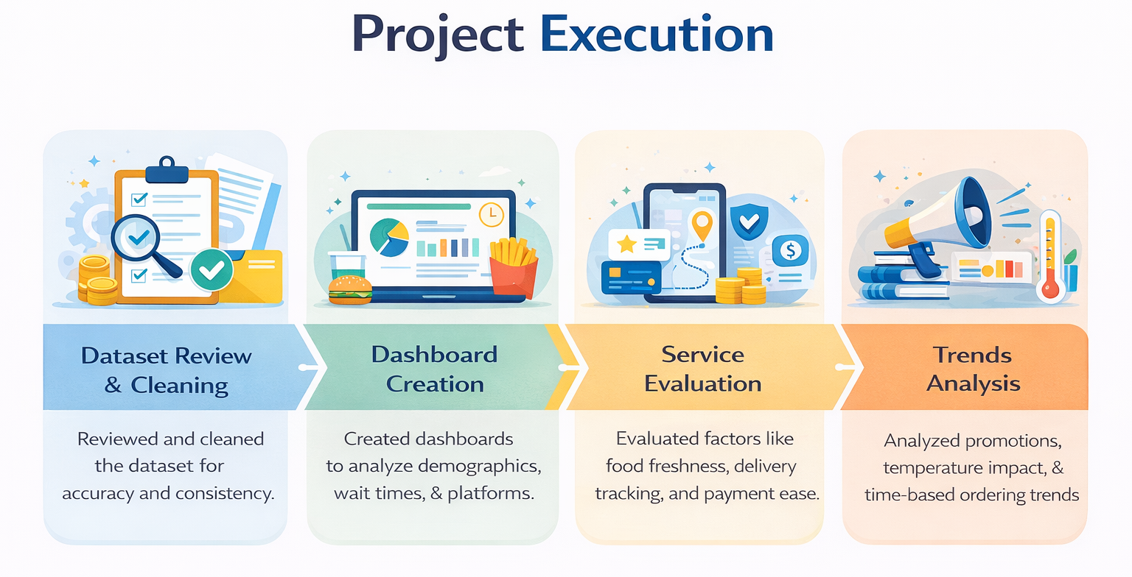

Slide 6
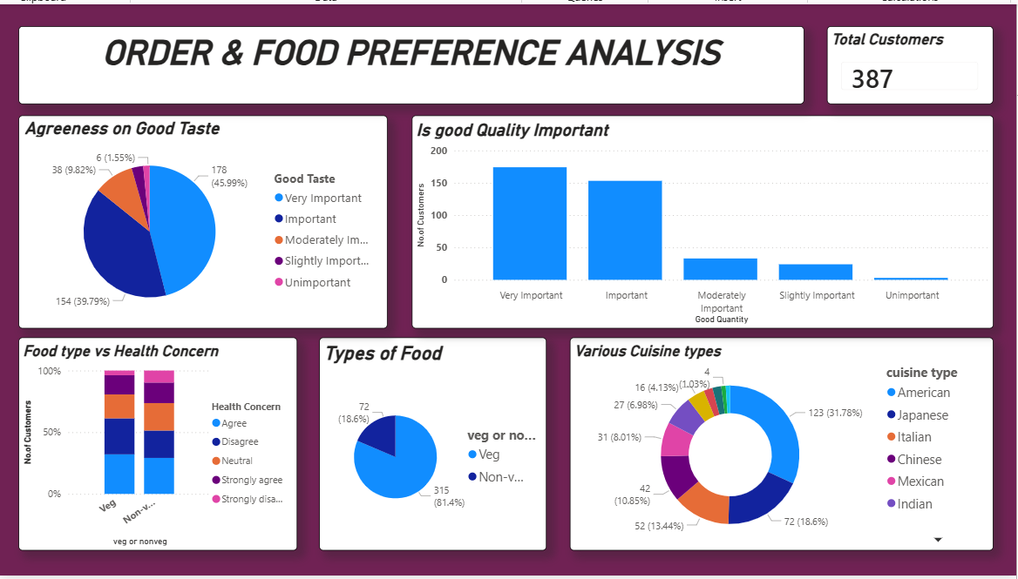
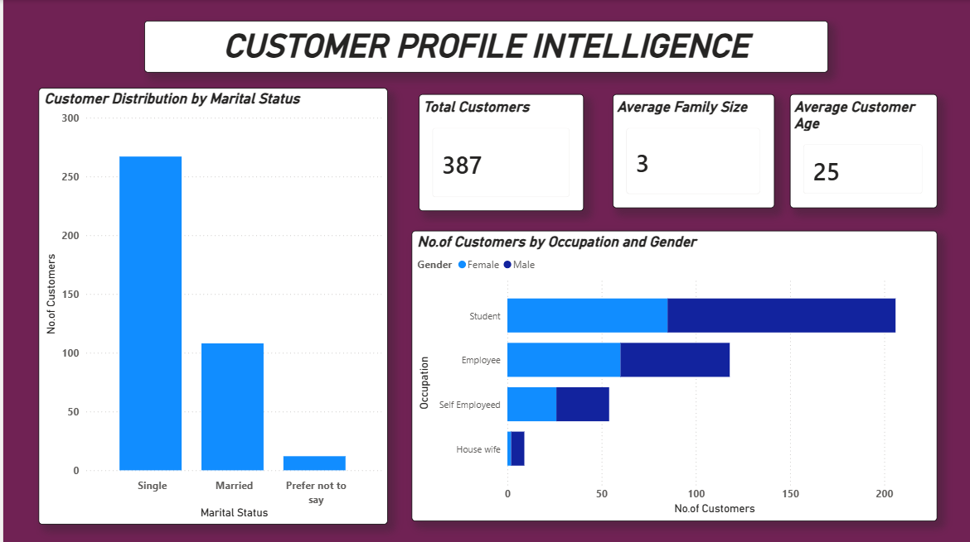
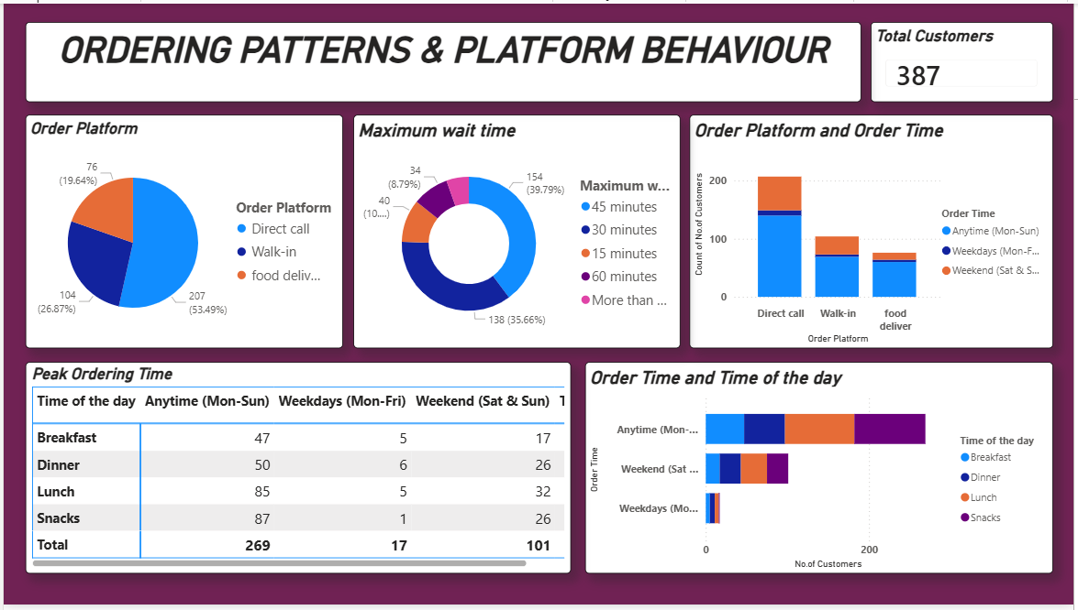
Dashboard Images

Slide 7
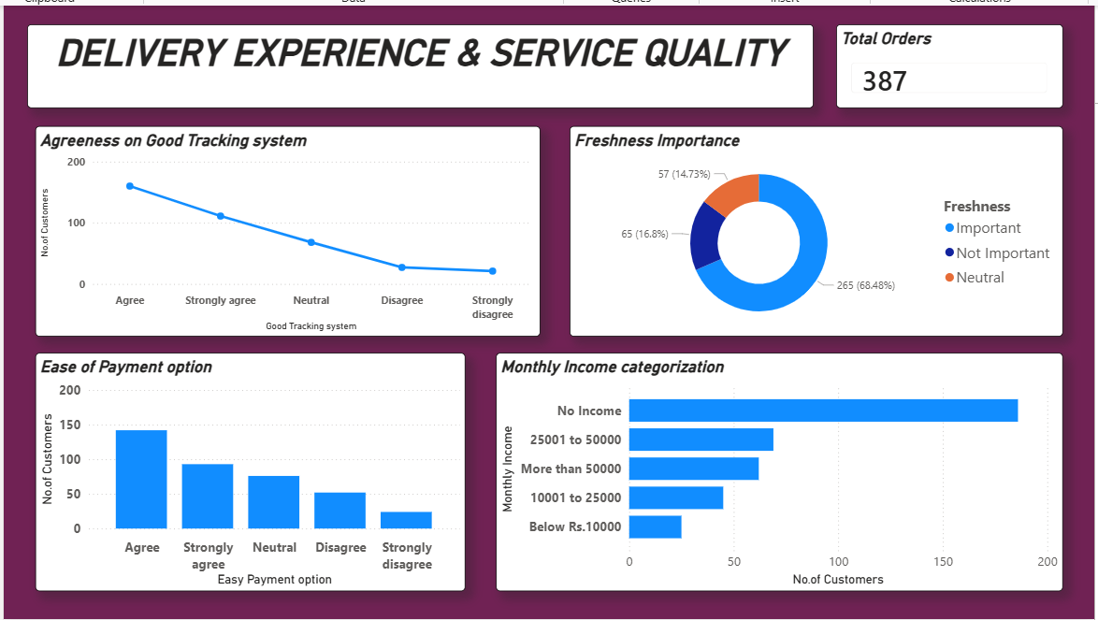
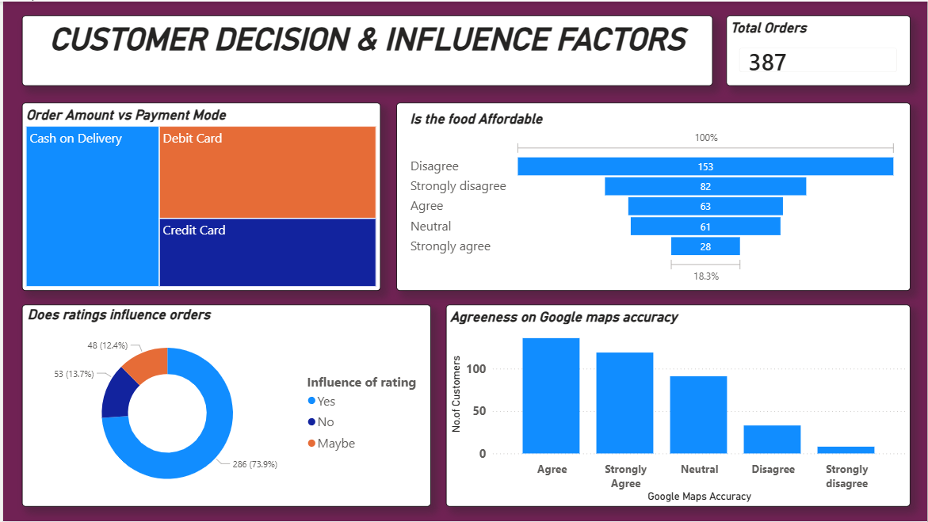
Dashboard Images

Slide 8
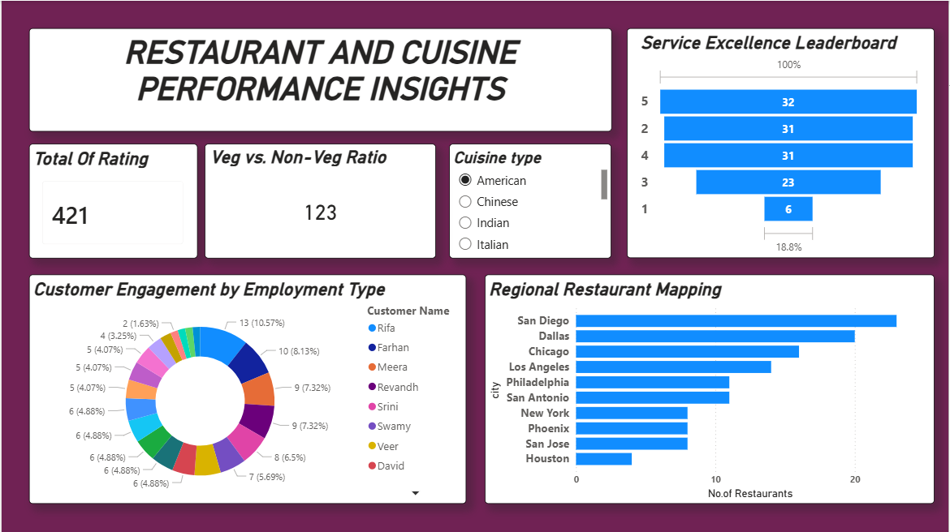
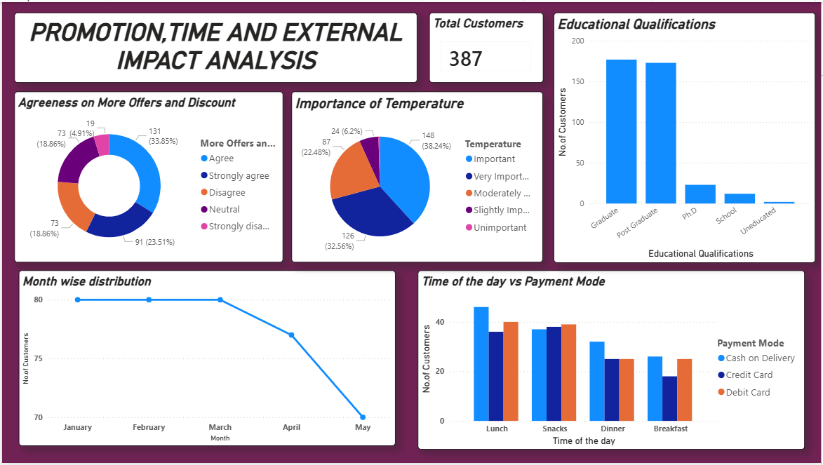
Dashboard Images

Slide 9
Challenges Faced and Resolution
Challenges Faced
Limited Team Collaboration in Power BI
Power BI Service does not support true parallel dashboard editing, which made simultaneous collaboration among team members difficult.
Frequent Version Updates
Every modification required publishing the report and pulling the latest version from the cloud, which slowed down the workflow and increased the risk of version conflicts.
Data Preprocessing Error
During data preprocessing, a column was accidentally deleted and went unnoticed initially. The issue was identified only after further progress in analysis, which affected data consistency and visualizations.
Resolution & Learnings
Adoption of Sequential Editing Workflow
A sequential editing workflow was adopted for Power BI dashboards to avoid conflicts and ensure controlled updates.
Clear Responsibility Assignment
Specific responsibility for report updates was assigned to team members to manage changes effectively and prevent overlap.
Data Recovery and Validation
The deleted column was recovered by copying and matching it from the original dataset. After recovery, all preprocessing steps, relationships, and visuals were revalidated.
Improved Validation Practices
The experience reinforced the importance of performing validation checks during data preprocessing in Power BI to maintain data accuracy and reliability.

Slide 10
Learnings and Skills Used
Power BI: Used for end-to-end Business Intelligence—from data ingestion to publishing interactive 7-page reports.
Power Query: Performed ETL (Extract, Transform, Load) to clean the Dataset.
Data Science & Visualization Skills:
Data Modeling: Established relationships between different data categories to ensure seamless filtering across all 7 dashboard pages.
DAX (Data Analysis Expressions): Created custom measures for "Average Rating," "Total Orders," and "Customer Sentiment Scores."
Advanced Visualizations: Implemented Slicers (for City/Gender), Decomposition Trees (to find influence factors), and Ribbon Charts (for trend analysis over time).
Interactive Reporting: Configured Cross-filtering and Sync Slicers so that a selection on the "Customer Profile" page reflects on the "Cuisine Performance" page.

Slide 11
Key Insights and Future Enhancement
Key Insights:
  Student Influence: A large portion of the dataset consists of students with "No Income," yet they frequently order "Veg" and "Snacks."
  Trust Factor: Google Maps accuracy and "Good Tracking Systems" are rated as "Important" by over 70% of respondents.
  Health Trend: There is a strong correlation between "Strongly Agree" on Health Concern and "Veg" food preferences.
Future Enhancement:
  Machine Learning Integration: Building a recommendation engine based on past ratings.
  Real-time Analysis: Integrating API data from live food delivery apps to study peak-hour trends.

Slide 12
Conclusion
Our comprehensive analysis reveals that the F&B industry has shifted from a Product-centric model to a Trust-centric model. Through our 7-page Power BI dashboard, we proved that while 'Taste' gets the first order, 'Transparency'—in the form of tracking accuracy and delivery speed—earns the second.
By identifying the high-volume student demographic and the surprising strength of direct-call ordering, we have provided a roadmap for brands to optimize their digital presence. Ultimately, success in today's market requires a balance of health-conscious options and seamless operational execution."

Slide 13
Acknowledgement:
We would like to express our heartfelt gratitude to the Infosys Springboard Team for organizing this valuable internship opportunity and providing a strong learning platform.
We sincerely thank our Mentor for her continuous support, guidance, and constructive feedback throughout the project.
We are also grateful to our teammates for their collaboration, encouragement, and valuable insights during the project work.
This internship has been a significant step in our professional growth and technical journey, helping us strengthen our skills in data analysis and visualization.
References:
Microsoft Power BI Documentation
Infosys Springboard Virtual Internship course materials
Dataset: order final.xlsx (from kaggle)

Slide 14
Thank You

